Slide 1


SHRIDEVI HACKATHON 2024
Eco-Flow Data Driven Solutions for Agricultural Runoff
Theme - Agriculture
Team Members Name – Shreyas M L, Vishwas S N,
Shravani M L, Harshitha Rani P S
College Name – Sambhram Institute of Technology
SHRIDEVI NATIONAL LEVEL HACKATHON - 2024

Slide 2
Agenda
Introduction
Objectives
Problem Statement
Technical Approach
Features
Challenges
SHRIDEVI NATIONAL LEVEL HACKATHON - 2024

Slide 3
INTRODUCTION
Team
ID : G58
Agriculture is the backbone of the country.
More than 70% of Indian income is based on agriculture.
Although agriculture contributes majorly for the Indian income but it is lacking in productivity due to manmade and environmental causes.
SHRIDEVI NATIONAL LEVEL HACKATHON - 2024

Slide 4
OBJECTIVES
Team
ID : G58
Collection of real time data on the surrounding farms.
Give suggestions to farmers based on the input given at that particular time on individual farms.
Predicting the flow of fertilizers during rainy season.
SHRIDEVI NATIONAL LEVEL HACKATHON - 2024

Slide 5
PROBLEM STATEMENT
Team
ID : G58
Proposed Solution
Agricultural runoff, particularly fertilizer runoff during heavy rainfall, poses a significant challenge to maintaining crop productivity and environmental sustainability.
The excessive movement of fertilizers from higher to lower lands leads to nutrient loss, reduced crop yields, and environmental pollution.
This project aims to analyze crop families and their fertilizer requirements to identify alternative crops and strategies that minimize nutrient runoff while sustaining agricultural productivity.
SHRIDEVI NATIONAL LEVEL HACKATHON - 2024

Slide 6
TECHNICAL APPROACH
Team
ID : G58
Machine Learning models- Decision Tree, Random Forest, Navies Bayes
Flask
Python- pandas
SHRIDEVI NATIONAL LEVEL HACKATHON - 2024

Slide 7
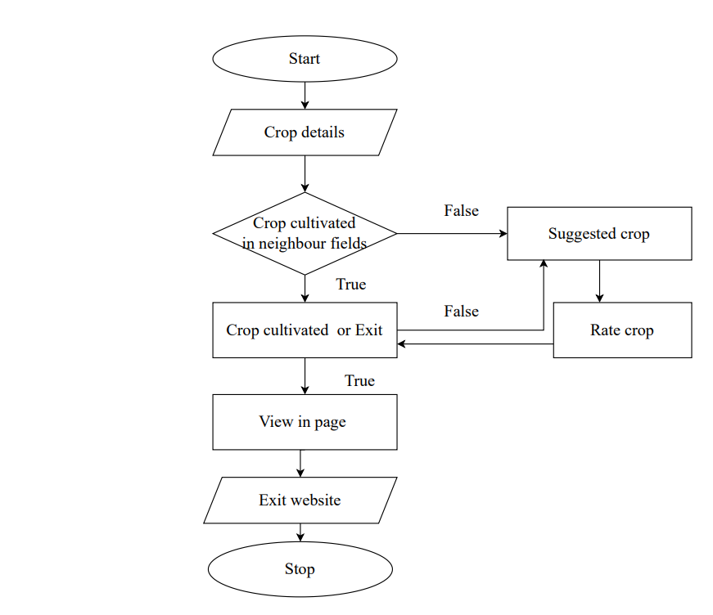
METHODLOGY
Team
ID : G58
Fig. 1.1 Flow Chart
SHRIDEVI NATIONAL LEVEL HACKATHON - 2024

Slide 8
FEATURES
Team ID : G58
Collection of real time data on the surrounding farms.
Give suggestions to farmers based on the input given at that particular time on individual farms.
Predicting the flow of fertilizers during rainy season.
Development of a website for convenient access and usage on smartphones and tablets.
Integration of user feedback and data collection to continuously enhance the recommendation system's performance.
SHRIDEVI NATIONAL LEVEL HACKATHON - 2024

Slide 9
CHALLENGES
Team ID: G58
Data and Infrastructure: Reliable data collection, real-time monitoring, and infrastructure setup are challenging, especially in remote areas.
Complex Modeling: Accurately predicting runoff and contamination requires sophisticated hydrological models.
Farmer Accessibility: Training and financial support are needed for farmers to use the system effectively.
Privacy and Maintenance: Ensuring data privacy and scaling the system sustainably are essential.

Slide 10
Thank You
Team ID:G58

